Slide 1

GROUP FUNCTIONS
By, Ms. P.olynia V. Kharbuli
Dept. of Computer Sc.
St. Anthony’s College, Shillong

Slide 2
Contents
What are group functions?
DISTINCT & ALL keywords
Types of GROUP functions
Using Multiple Functions
Group By Clause
Affect on other clauses when using GROUP BY
Grouping-based on multiple columns
Having Clause
Sample Table for Group By Clause
Nesting of Group Functions

Slide 3
What are Group Functions?
A group function performs an operation on a set of data. Group functions are ANSI-standard SQL functions.
Group functions operate on set of rows and return one result per group. The set of rows can be an entire table or only part of the table.
Group functions are also called Multi-row functions
There are also Single-row functions, which return one result per row.

Slide 4
What are Group Functions?
Syntax:
SELECT group_function (argument)
FROM table_name;
To specify a group function, you write the name of the function followed by an argument in parentheses.
The argument can be
a column name,
an expression, or
a constant.

Slide 5
DISTINCT & ALL KEYWORDS
Syntax:
SELECT group_function (DISTINCT (column_name))
SELECT group_function (ALL (column_name))
If you add the DISTINCT keyword to the argument, then the function considers only non-duplicate values within the group specified.
If you add the ALL keyword, the function considers every value, including duplicates. You do not need to specify ALL because this is the default value.

Slide 6
Types of Group Functions
AVG
SUM
STDDEV
VARIANCE
MIN
MAX
COUNT
____________________________________________________
NULL Value
Group functions ignore null values, except the group function COUNT (*) that does not ignore null values when it counts rows.

Slide 7
AVG Function
Syntax:
SELECT AVG (column_name)
FROM table_name;
You can find the average of a group of values by using the AVG function.
Arguments can be:
a column name or
expression of the NUMBER data type in parentheses.
To specify additional functions or columns, you separate items in the SELECT list with a comma.

Slide 8
SUM Function
Syntax:
SELECT SUM(column_name)
FROM table_name;
The SUM function finds the total of all values in the group specified
Arguments can be:
a column name or
expression of the NUMBER data type in parentheses.

Slide 9
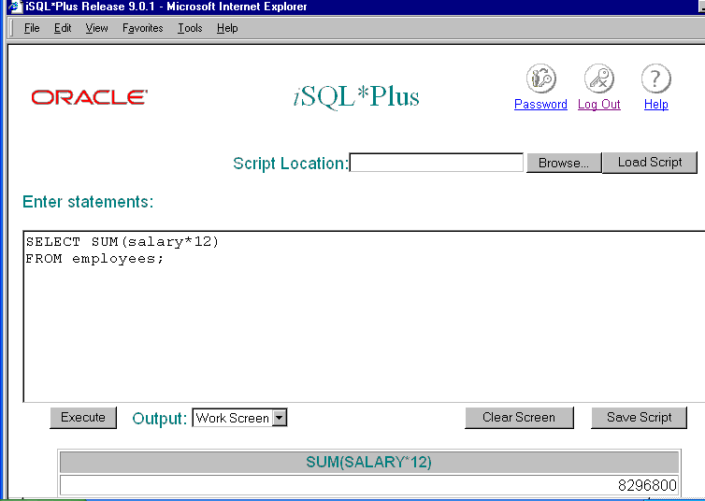

Slide 10
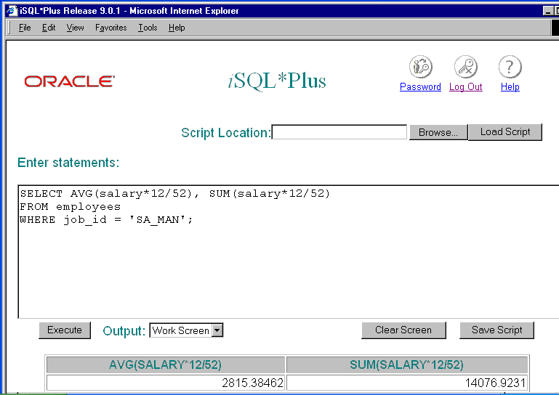
Multiple functions being used

Slide 11
STDDEV & VARIANCE Function
Syntax:
STDDEV(column_name)
VARIANCE(column_name)
The SQL functions accept only a NUMBER argument for
AVG
SUM
STDDEV and
VARIANCE
For formula, refer to https://www.mathsisfun.com/data/standard-deviation-formulas.html as on 07-03-2017

Slide 12
MIN & MAX Function
Syntax:
SELECT MIN|MAX(column_name)
FROM table_name;
These functions can accept any data type

Slide 13
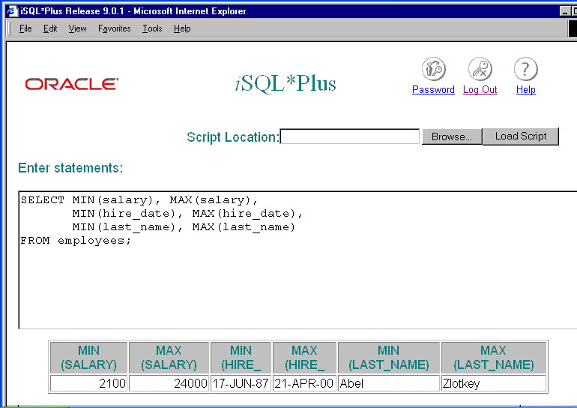

Slide 14
COUNT Function
Syntax:
SELECT COUNT(column_name|expression|*)
FROM table_name;
The COUNT function returns the number of rows in a specified group.
You can use the COUNT function with different data types.
If you use the COUNT function with a column name or expression, it ignores null values.
However, when used with an asterisk(*), the function counts all rows that contain at least one value that is not null.

Slide 15
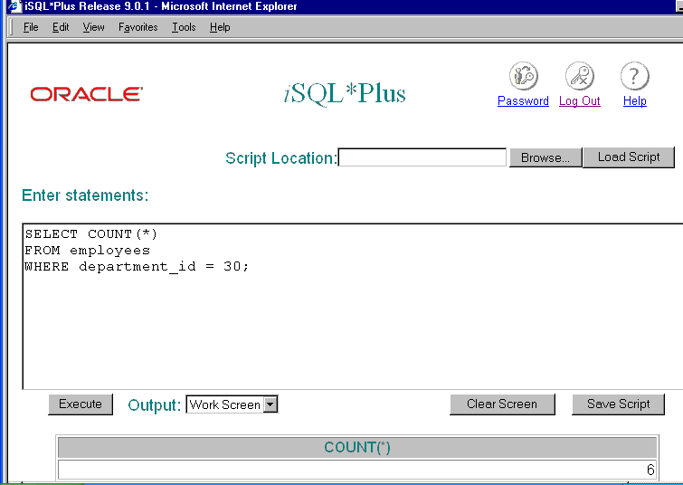

Slide 16
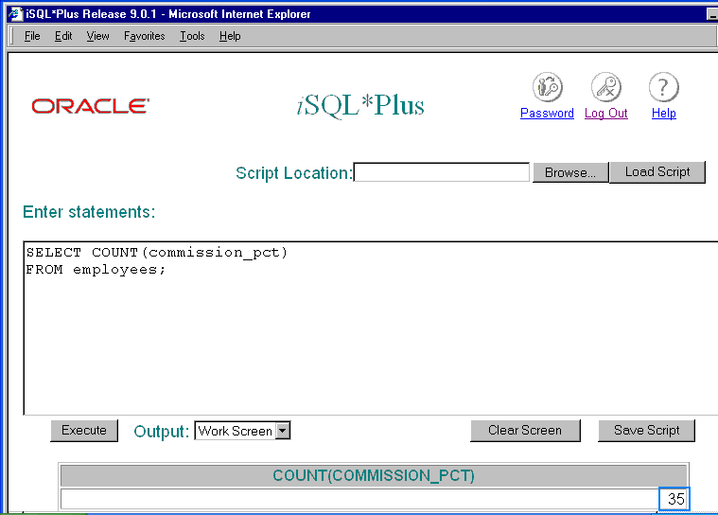

Slide 17


Slide 18
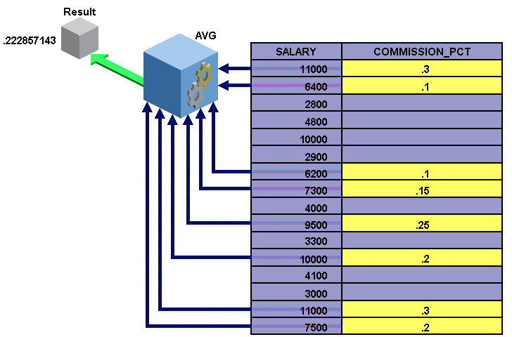
For example, the AVG function divides total commission percentage by 35 because only 35 employees earns a commission. The AVG function ignores the 72 employees in the table who have a null value in the COMMISSION_PCT column.

Slide 19
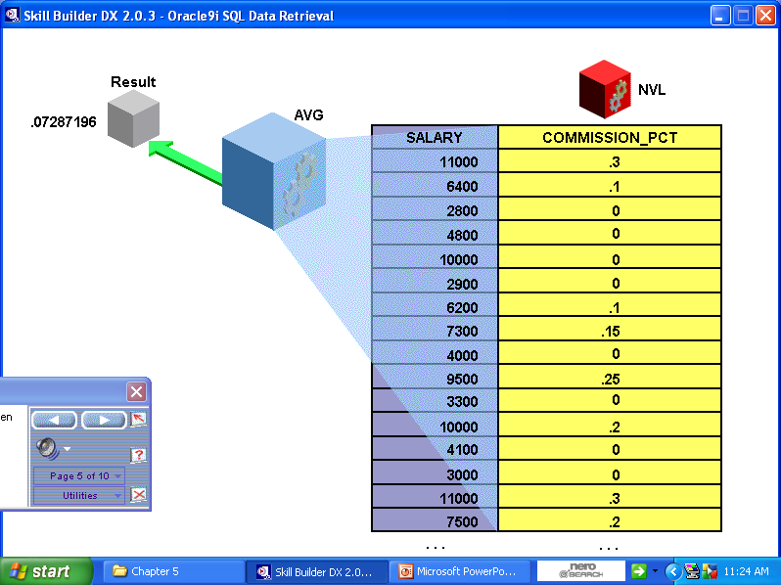
NVL Functions
If you want a group function to include null values in the result, then you can this function.
The NVL function is a single-row function that replaces a null value with an actual value.

Slide 20


Slide 21
Group by Clause
Syntax:
SELECT column-list,group_function(column)
FROM table_name
[WHERE condition]
GROUP BY column-list|exp;
[ORDER BY column1;]

Slide 22
Group by Clause
You use the GROUP BY clause to organize rows in a table into groups.
You can then use the group functions to return information for each group. For example, you can group data in the employees table by department number and then return the average salary for each department.
You place the GROUP BY clause between the WHERE and ORDER BY clause in a SQL statement.
You specify the GROUP BY keyword followed by a column name or expression that indicates how you want to group the rows.
You cannot use a column alias in the GROUP BY clause.

Slide 23
Affect on other clauses when using GROUP BY
SELECT clause can contain only the column or columns that appear in the GROUP BY clause, in addition to any group function or functions.
Using a WHERE clause with a GROUP BY clause is optional. You can use a WHERE clause to exclude rows before dividing them into groups.
By default, rows are sorted in ascending order of the columns included in the GROUP BY list. You can override this order by using the ORDER BY clause.
Having clause can be used. It’s an optional clause but applicable only when Group By is present

Slide 24
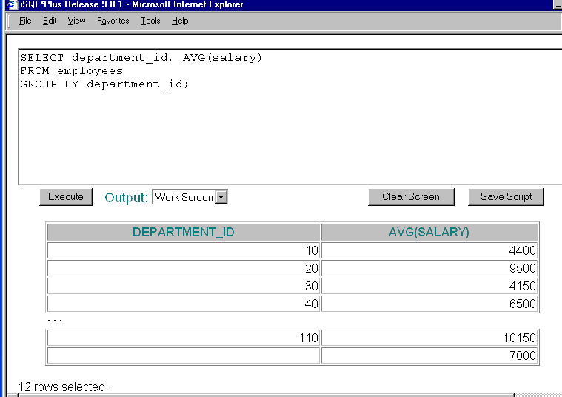

Slide 25
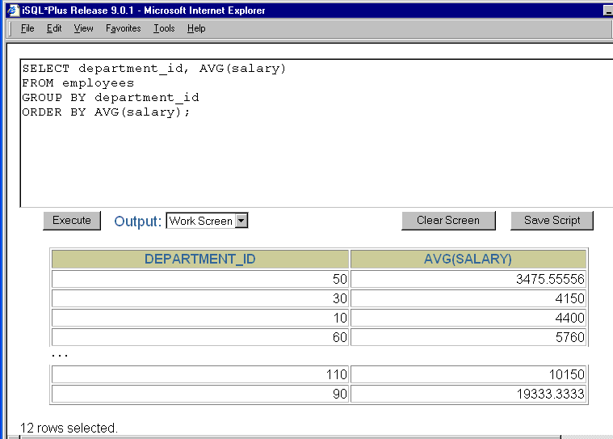

Slide 26
Grouping based on multiple columns
Syntax:
SELECT column1, column2, group_function(column)
FROM table_name
[WHERE <condition>]
GROUP BY column1,column2
[ORDER BY column1;]
When you specify multiple columns in the GROUP BY clause, you separate column names with a comma.
The order of the columns in the GROUP BY list determines the order in which the columns are grouped

Slide 27
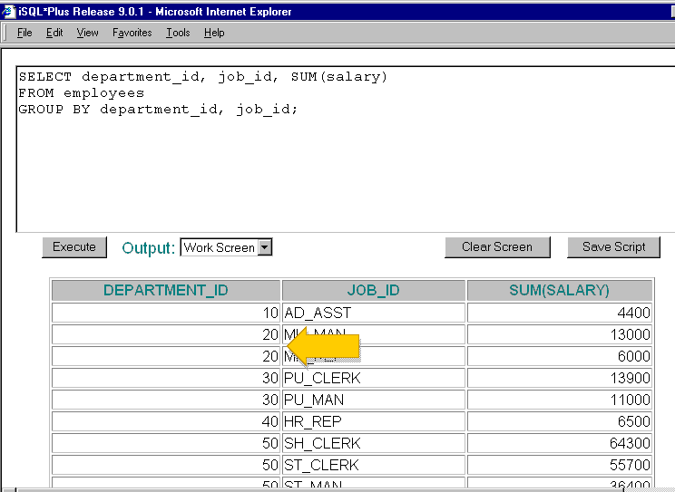
Will result change if order of grouping changes?
Yes. What result will be seen due to change?

Slide 28
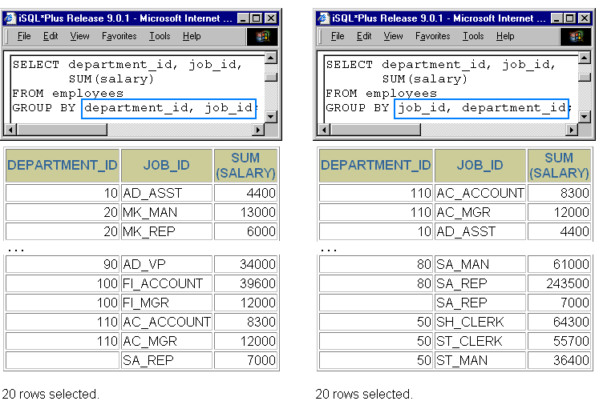

Slide 29
Having Clause
Syntax:
SELECT column1, group_function(column)
FROM table_name
[WHERE <condition>]
GROUP BY column1
HAVING condition
[ORDER BY column;]
This clause when added restricts the number of groups that can be retrieved.
Each group must satisfy the having condition

Slide 30
Having Clause
You can use the HAVING clause to specify conditions that must be true for a group of rows to be retrieved.
You place the HAVING clause immediately following the GROUP BY clause in the syntax.
You specify the HAVING keyword followed by a condition that refers to a group of rows.
You cannot use a HAVING clause in a statement without a GROUP BY clause.
As in the GROUP BY and WHERE clauses, you cannot use a column alias in a HAVING clause.

Slide 31
Sample Table for Group By Clause
Employees
Emp_no | Emp_name | Dept_No | Salary
1 | Alice | 10 | 18000
2 | Rueben | 20 | 20000
3 | Jimmy | 10 | 15000
4 | John | 20 | 8000
5 | Jane | 30 | 30000
Query
Find the total salary earned by each department
Find the list of department earning total salary greater or equal to 30000
Show the department having the maximum total salary
Show the department having more than 1 employee

Slide 32
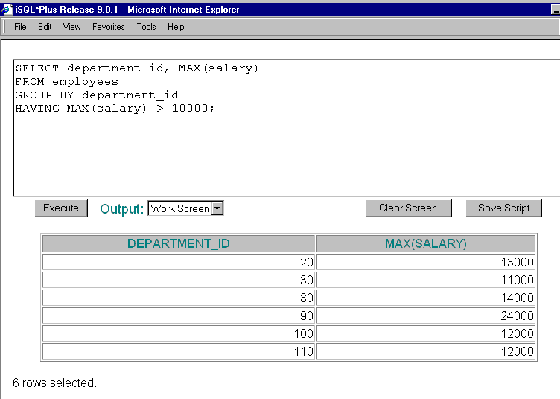

Slide 33
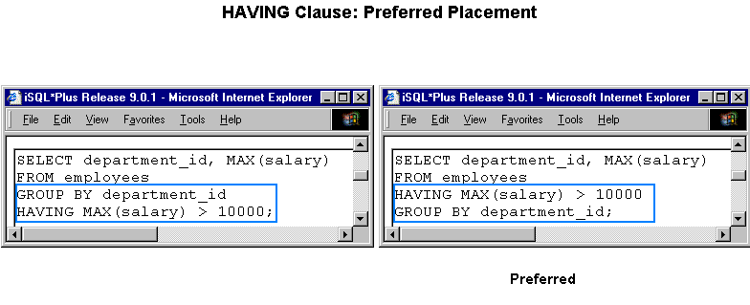
Your statement will still execute if you place the HAVING clause before the GROUP BY clause.
However, it is more logical to place the clause after the GROUP BY clause.

Slide 34
Nesting of Group Functions
You can nest group functions to a depth of two
When group functions are nested, the Oracle server evaluates the inner function before the outer function
Example: Function1(Function2(column_name))

Slide 35
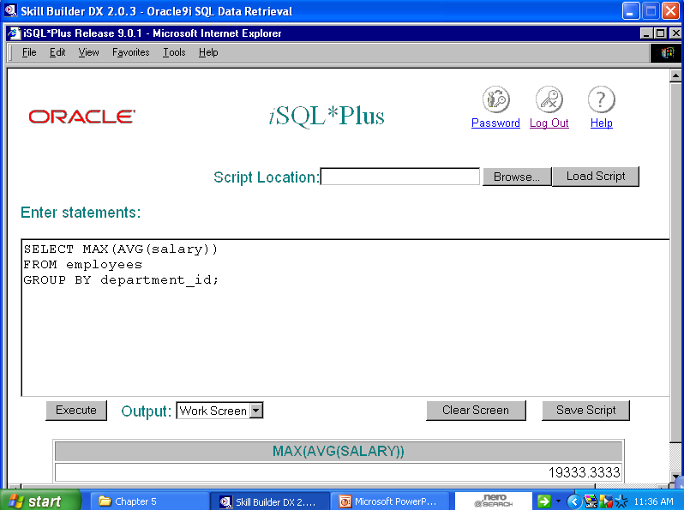

Slide 36
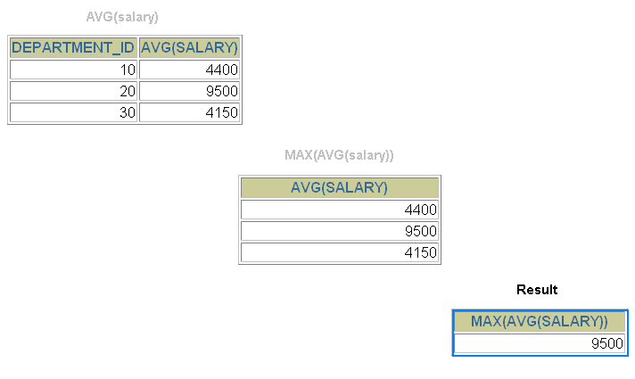

Slide 37
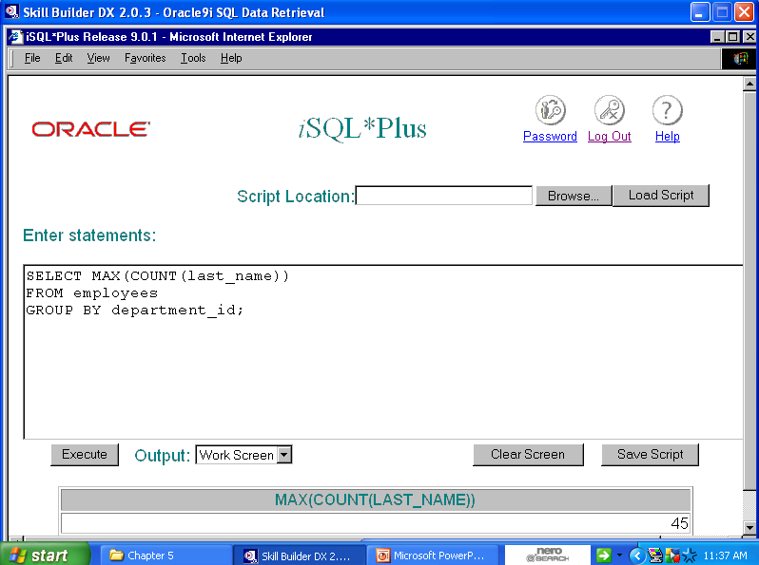

Slide 38


